Slide 1
FUND SEEKER

Slide 2

LANDING PAGE
After Clicking the provided URL, Fund Seeker (FS) would be shown the landing page.

Slide 3
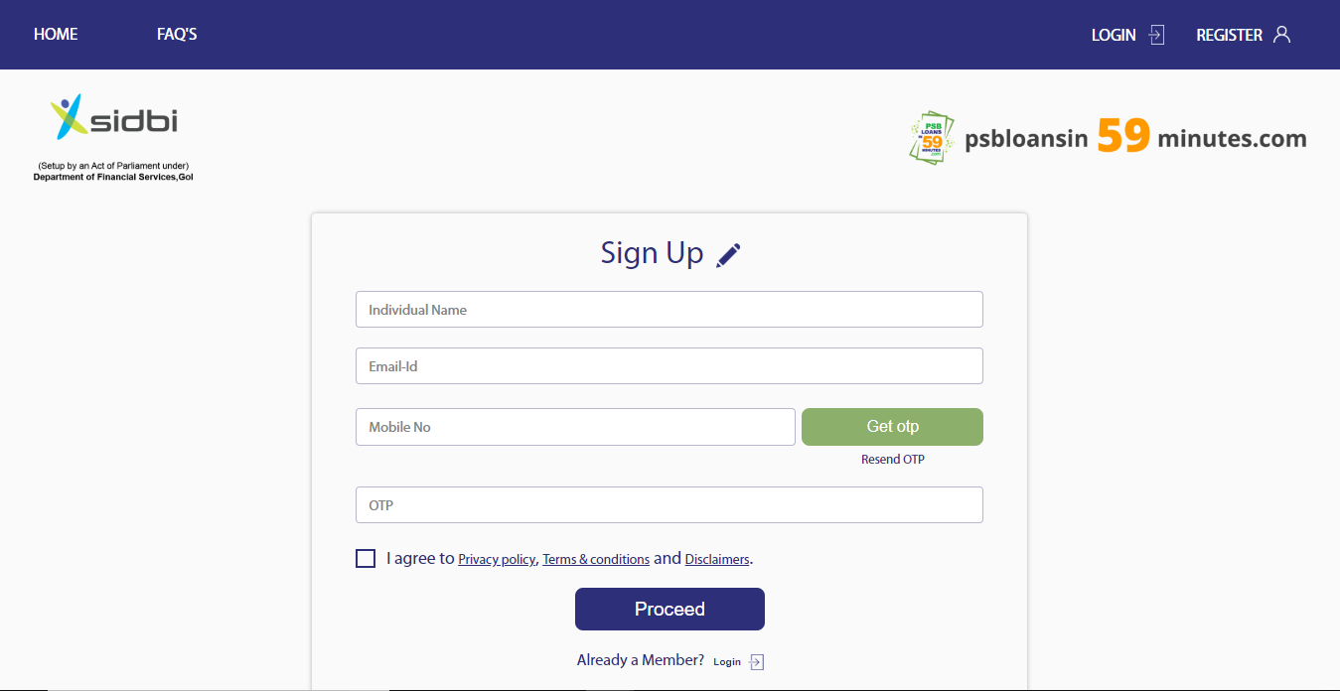
REGISTRATION PAGE
The first page of Contactless loans. FS will register by providing His/Her Name, Email ID and Mobile number. Thereafter FS will receive an OTP on the mobile number which needs to be verified and will proceed further.

Slide 4
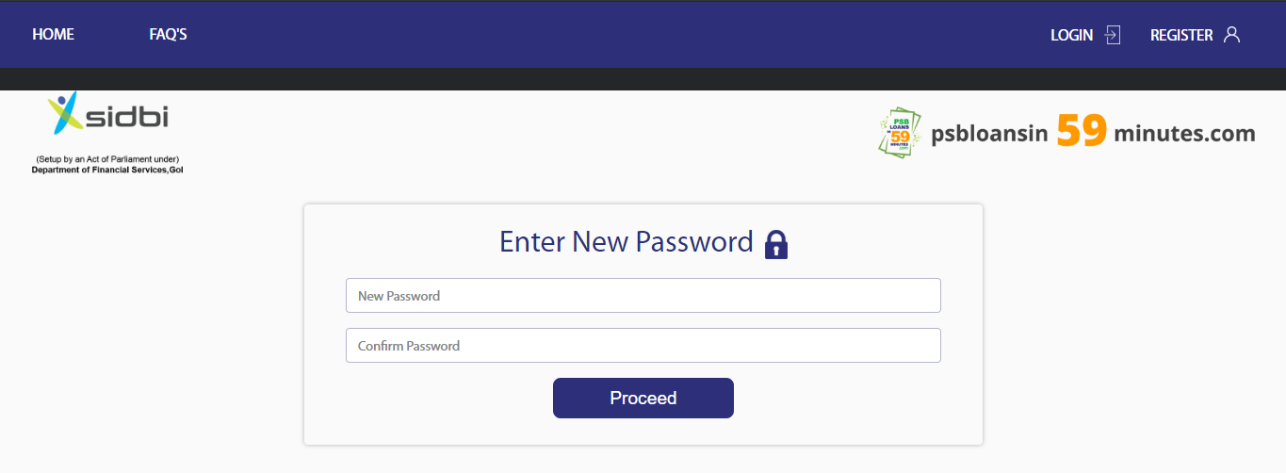
SET PASSWORD
Once the Registration process is completed, the FS will set a New Password which will also be used for future logins.

Slide 5
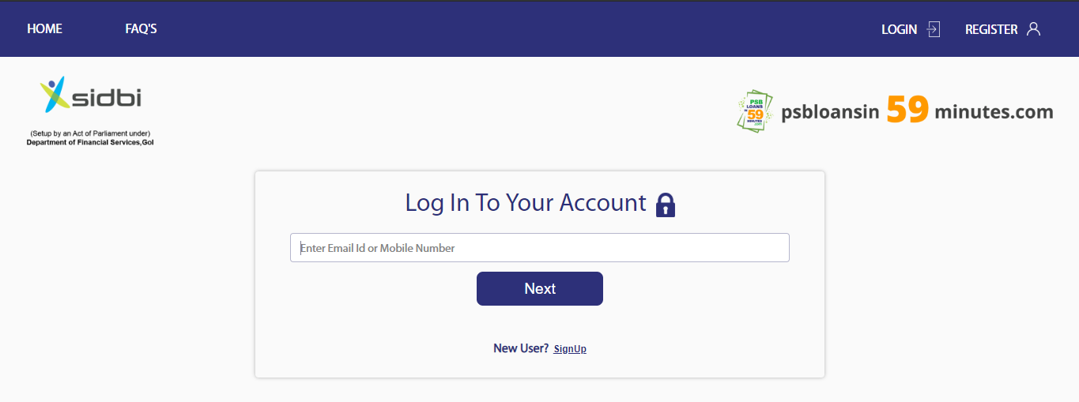
LOGIN PAGE
If FS is already a registered user, he can login by entering registered Email ID and password or mobile number and OTP.

Slide 6
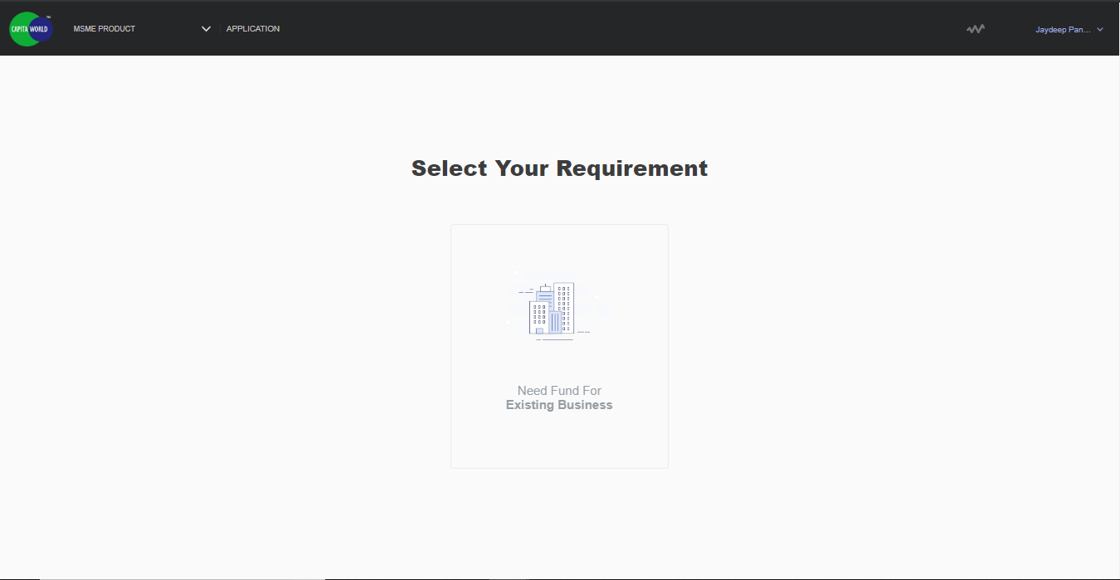
Select Your Requirement
FS will select the requirement where options will be provided.

Slide 7
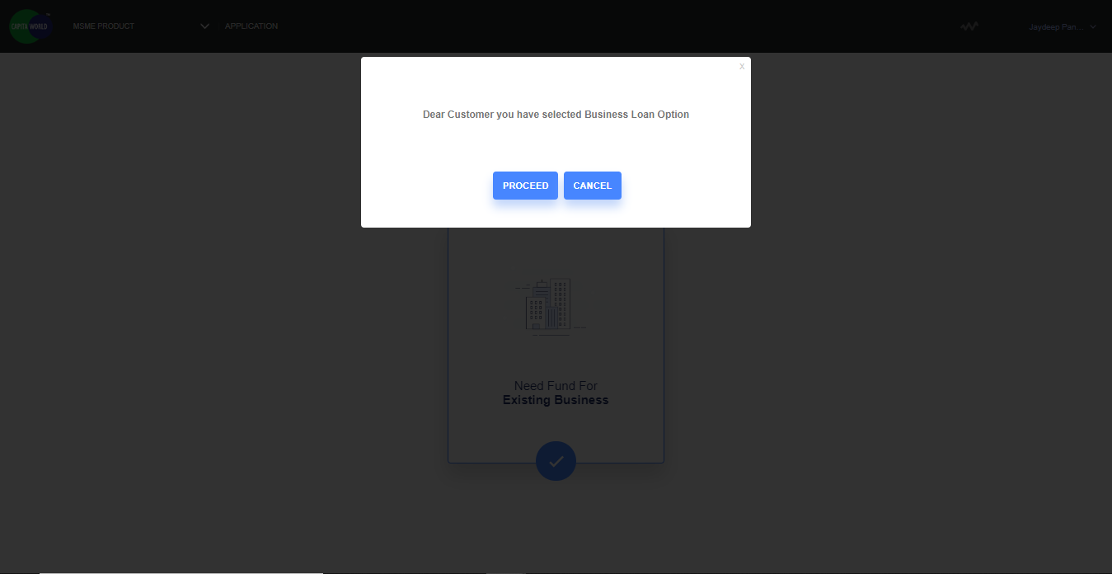
Select Your Requirement
FS will select the requirement where options will be provided and user will have to confirm the selected options.

Slide 8
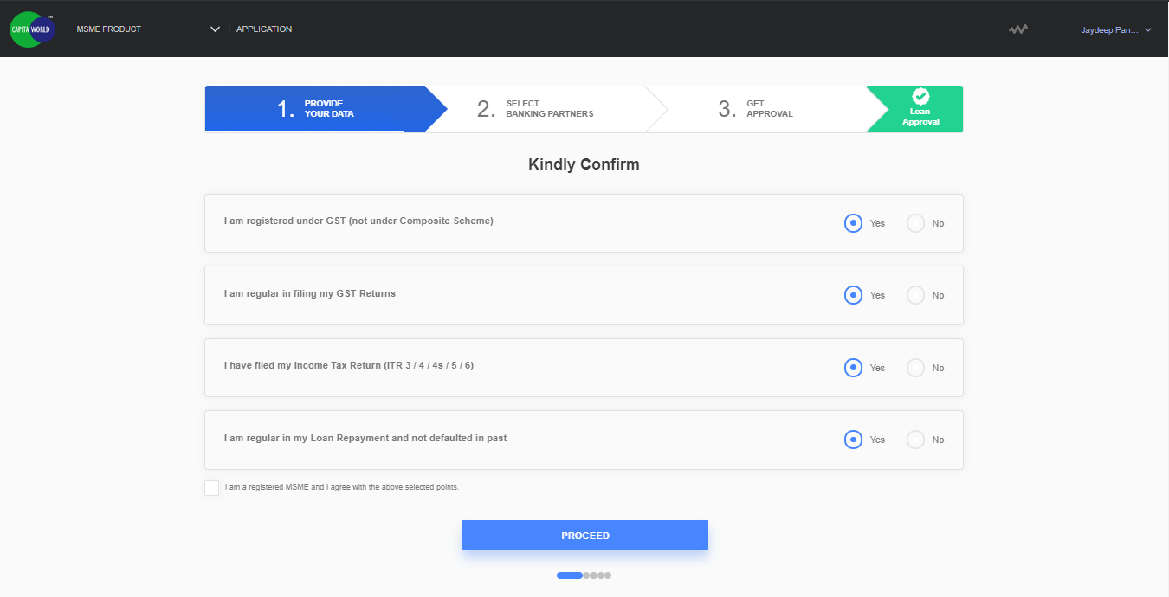
STEP 1: BASIC QUESTIONS
FS has to answer 4 basic questions and provide consent that “They are registered MSME” and other T&C.

Slide 9
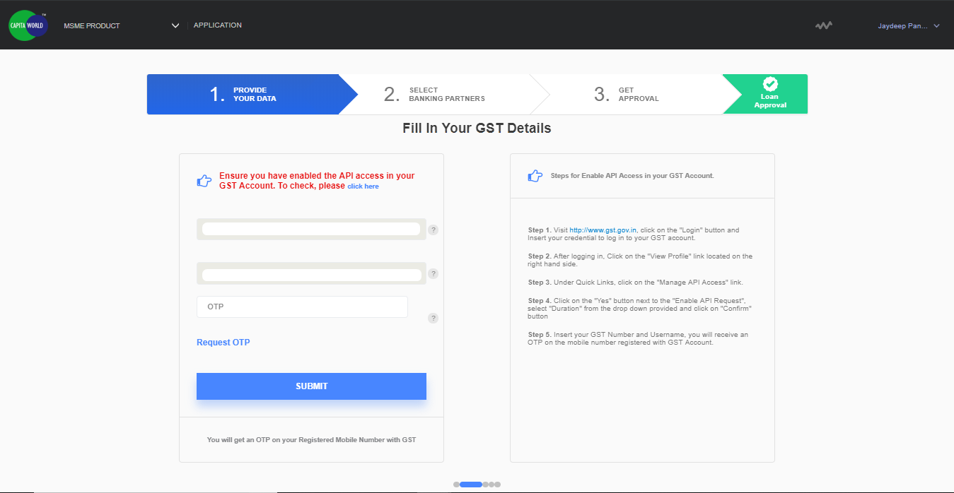
STEP 2: GST DETAILS
FS will provide the GST number and GST username to login. FS can either login through “PASSWORD” or opt to login through “OTP” to proceed ahead.

Slide 10
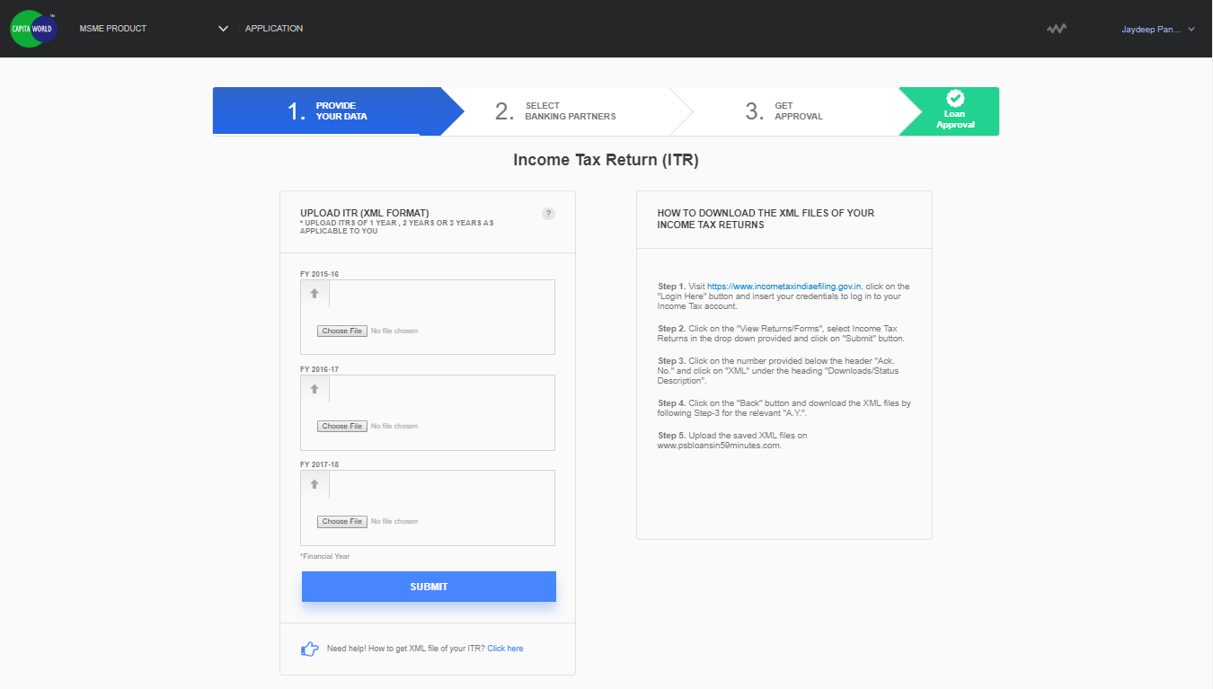
STEP 3: ITR LOGIN
After GST data is Successful fetched, FS needs to provide ITR details. FS can either upload ITR for the last 3 years in XML format or enter the Date of Incorporation to login. The PAN Number would be auto-filled.

Slide 11
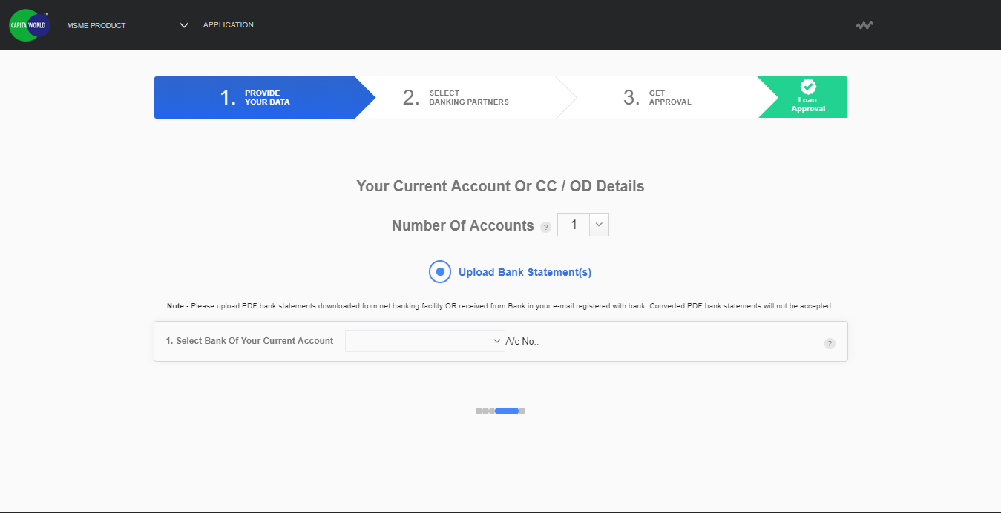
STEP 4: BANK STATEMENTS
After Successful ITR data fetch, FS needs to provide Bank Statements. FS can upload the e-statement (PDF) provided by banks. FS can provide multiple bank statement which need to be mentioned in Number of Accounts section.

Slide 12
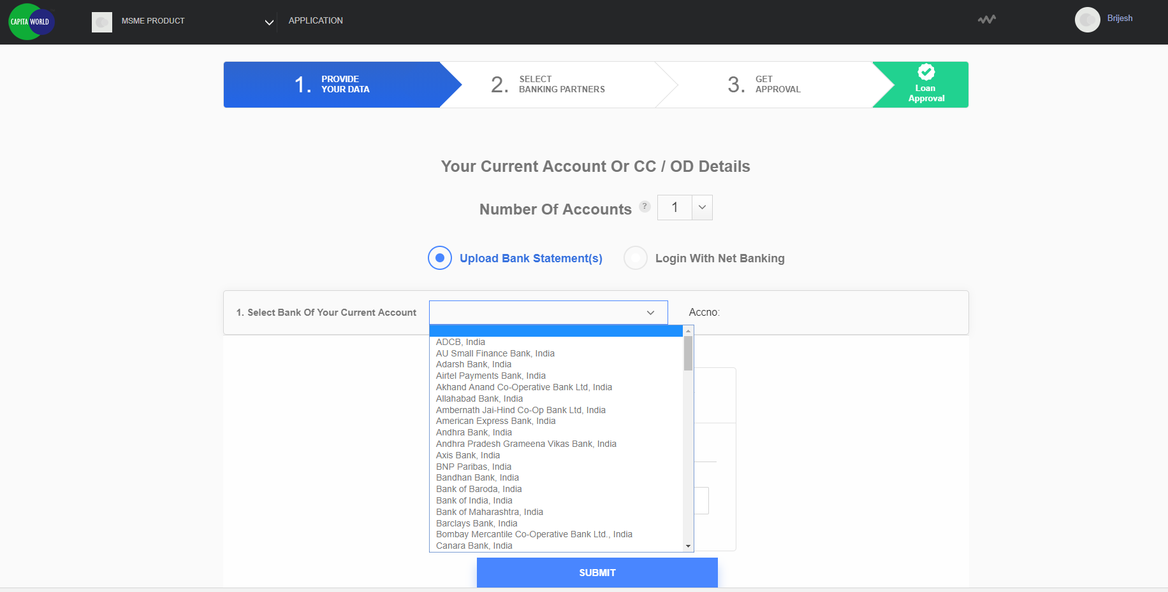
OPTION 1: UPLOAD
After entering the No. of Accounts FS has to select the Name of the Bank that he has an account in and then FS can upload the Statements.

Slide 13
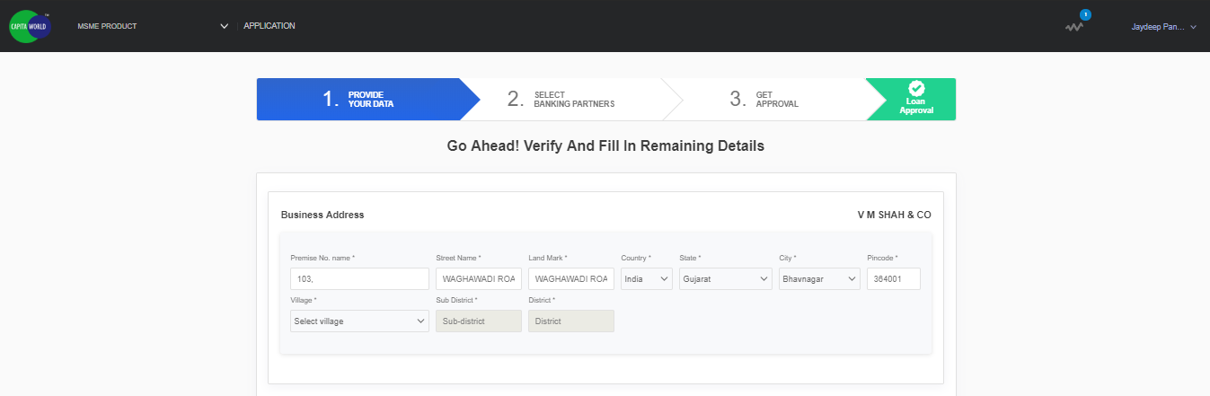
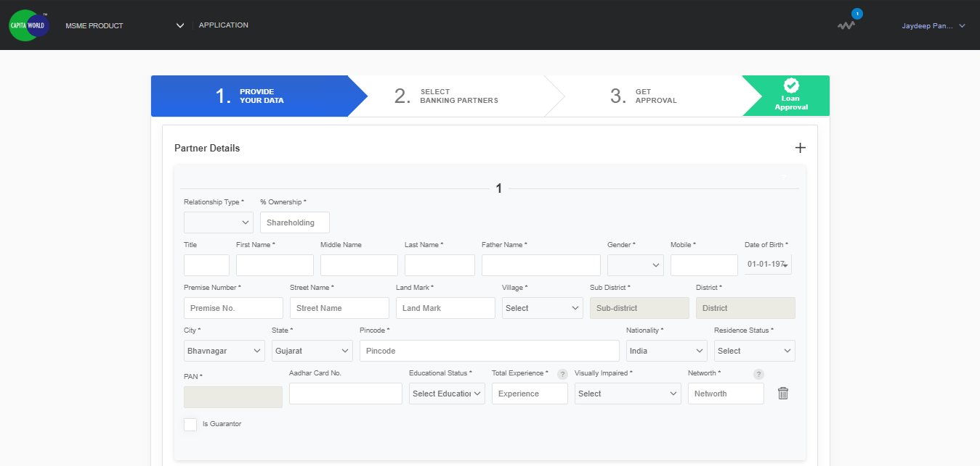
STEP 5A: MANUAL QUESTION
Post successful Bank Statement data fetch, FS verifies all the information and provide additional details for Individual/Commercial Bureau fetch (For Eg: CIBIL Individual/CIBIL Commercial Report).

Slide 14
STEP 5A: MANUAL QUESTION
Post successful Bank Statement data fetch, FS verifies all the information and provide additional details for Individual/Commercial Bureau fetch (For Eg: CIBIL Individual/CIBIL Commercial Report).

Slide 15
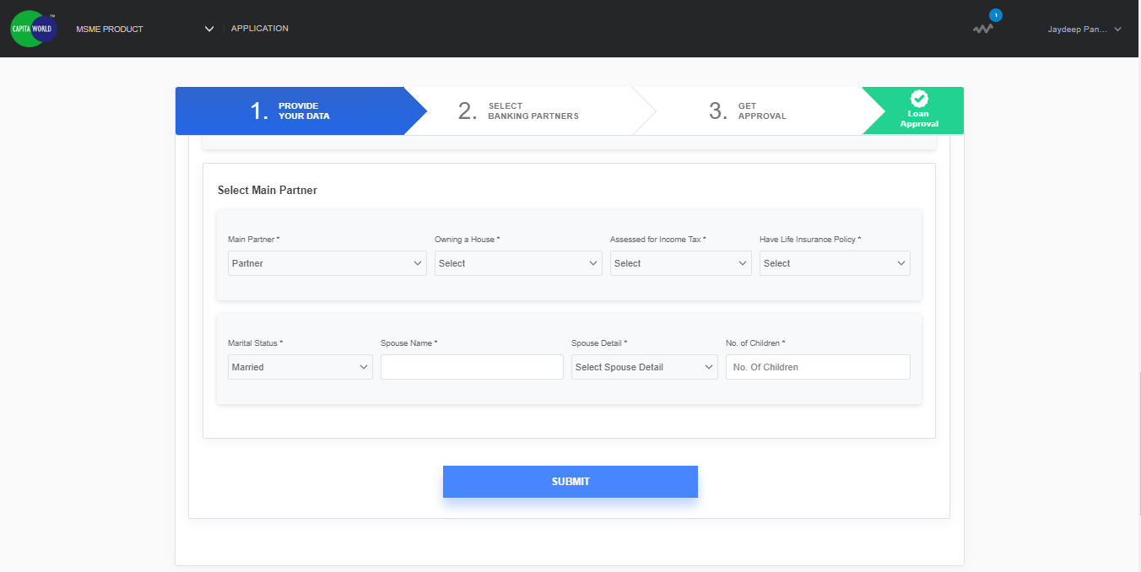
STEP 5A: MANUAL QUESTION
Post successful Bank Statement data fetch, FS verifies all the information and provide additional details for Individual/Commercial Bureau fetch (For Eg: CIBIL Individual/CIBIL Commercial Report).

Slide 16
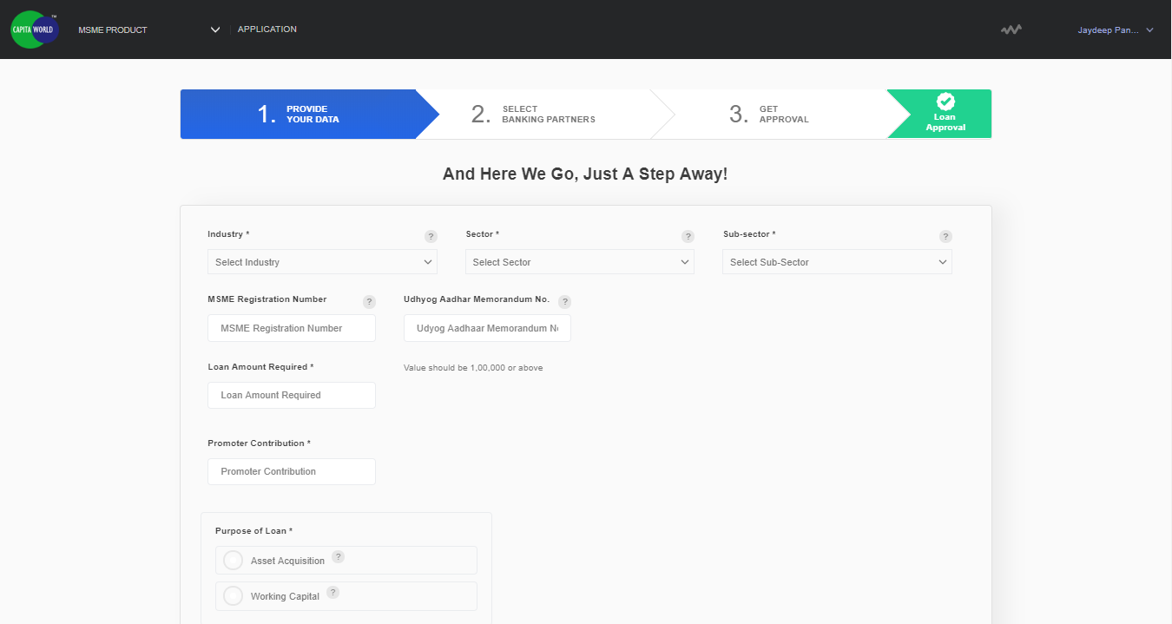
STEP 5B:MANUAL QUESTIONS
After successful bureau data fetch, FS need to provide additional details for loan proposal applied for. Existing loans data gets auto fetched from bureau but FS need to provide bank name details.

Slide 17
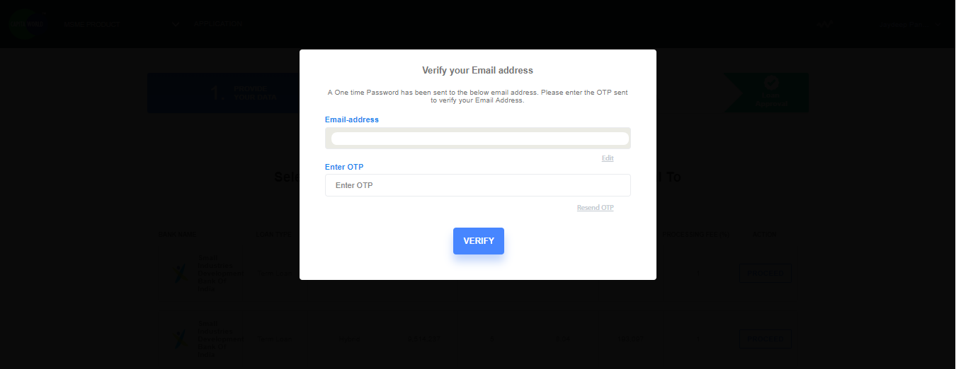
EMAIL VERIFICATION
The Email ID has to be verified before proceeding further. The OTP sent to registered e-mail has to be entered to complete the verification.

Slide 18
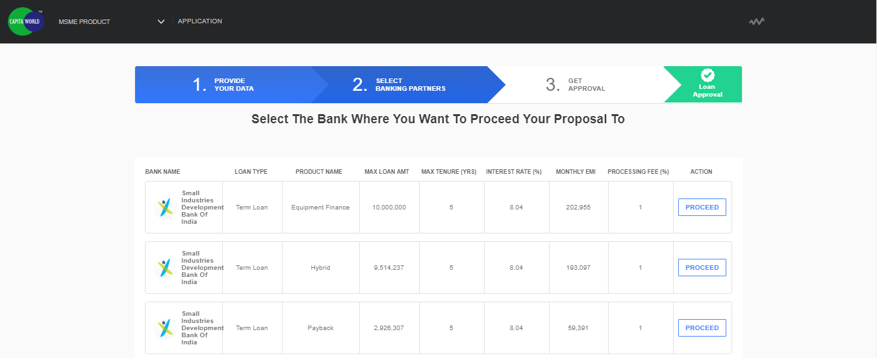
STEP 6A: BANKING PARTNERS
FS receives a list of banks with following details:
1. Bank Name 5. Interest Rate
2. Loan Type 6. Monthly EMI
3. Max Loan Amount 7. Processing Fee
4. Max Tenure 8. Action i.e. the option to proceed
with a particular Bank

Slide 19
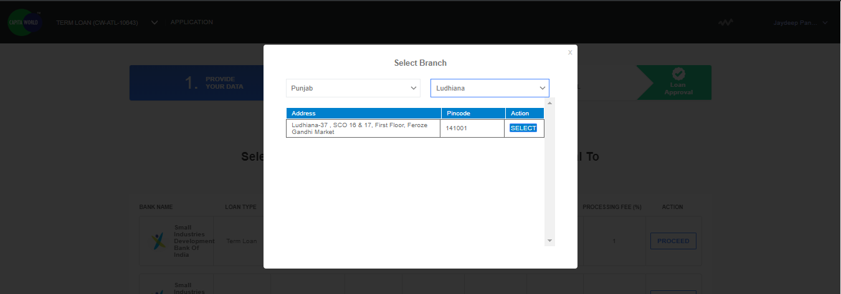
STEP 6B: SELECT BRANCH OFFICE
After selecting the Banking Partner, FS will be asked to select the state and city and further would be shown all the Branch Offices of that particular Bank based on State/City selected. FS will have to select which Branch Office should the Proposal be submitted to.

Slide 20
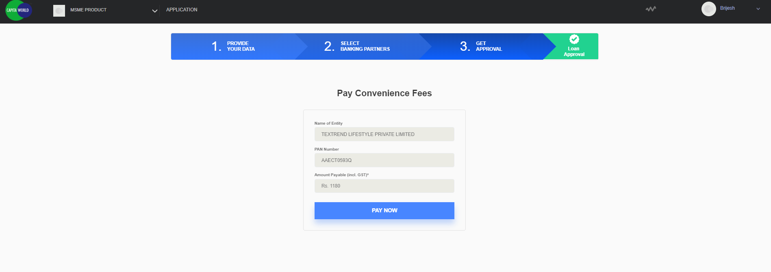
STEP 6C: PAYMENT
FS need to pay convenience fees. CGTMSE cost is not included in the convenience fees.

Slide 21
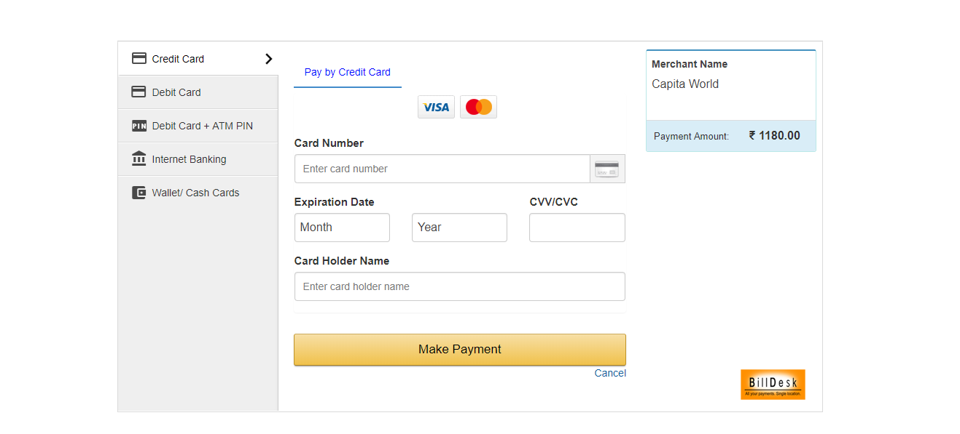
PAYMENT
FS would be given option of Net Banking, Credit/Debit Cards and Wallets to make Payment.

Slide 22
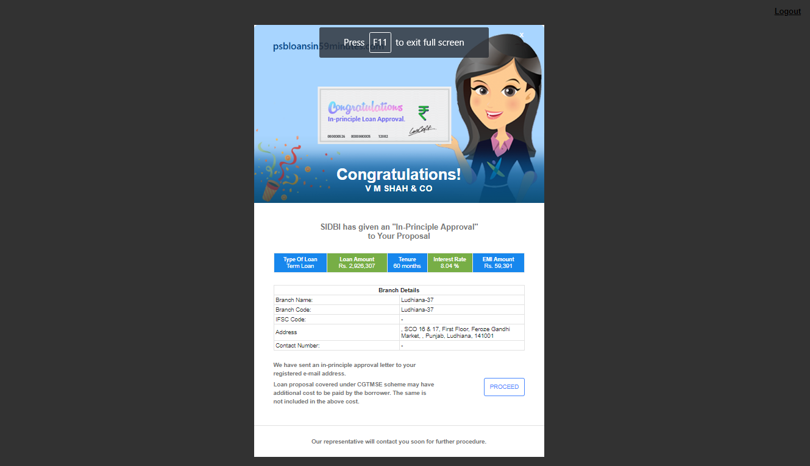
IN-PRINCIPAL APPROVAL
After paying the Convenience Fee, FS will get In-Principal Approval Letter which can be downloaded for future reference.

Slide 23
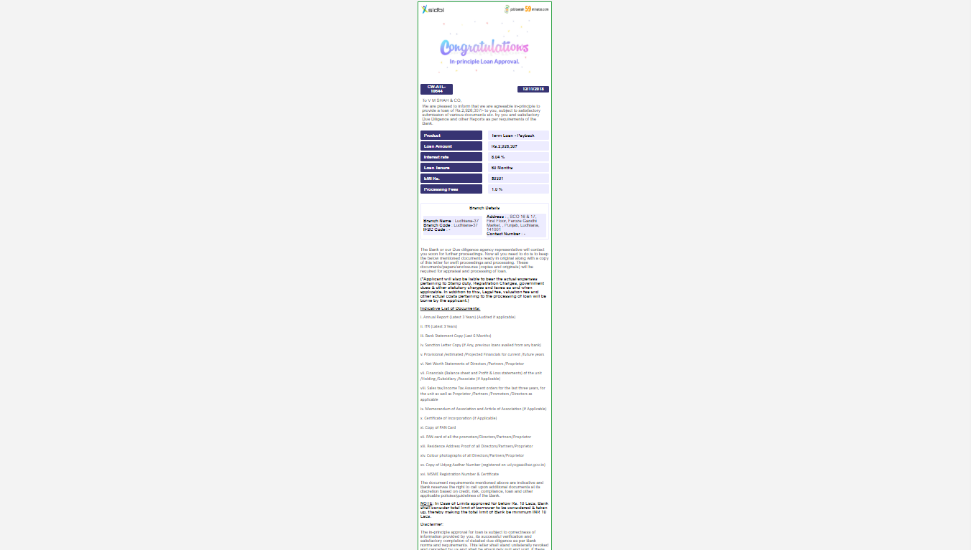
IN-PRINCIPAL APPROVAL
FS download the In-Principal Approval Letter.

Slide 24
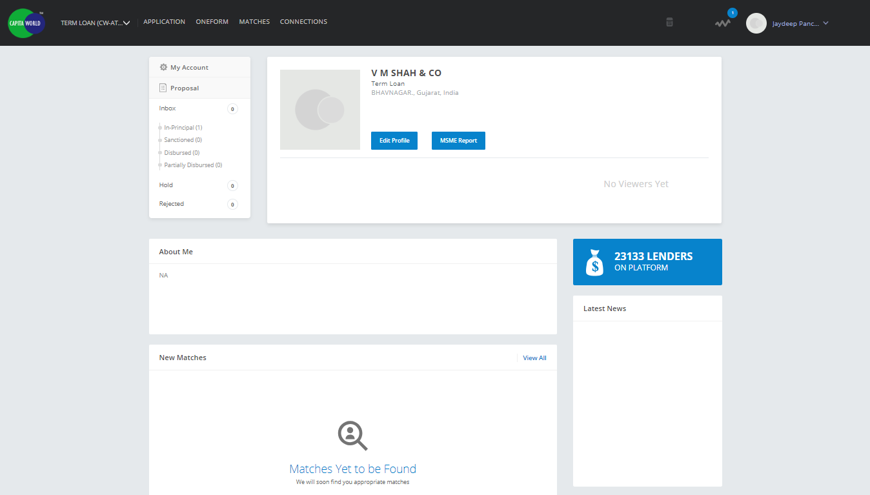
FS DASHBOARD
After proceed from the In-Principal Approval page, FS would be redirected to Dashboard where FS can check the status of the loan proposal.

Slide 25
THANK YOU

